Slide 1
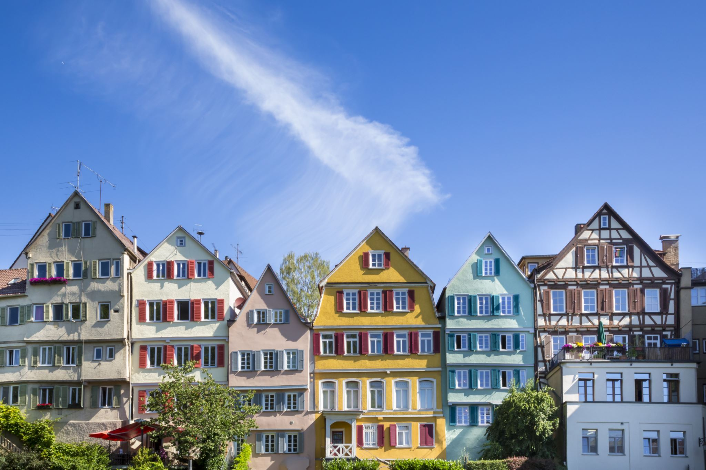
CONSTANCE

Slide 2





STRUCTURE
Geography
Weather
Nature
Culture
Tourism

Slide 3
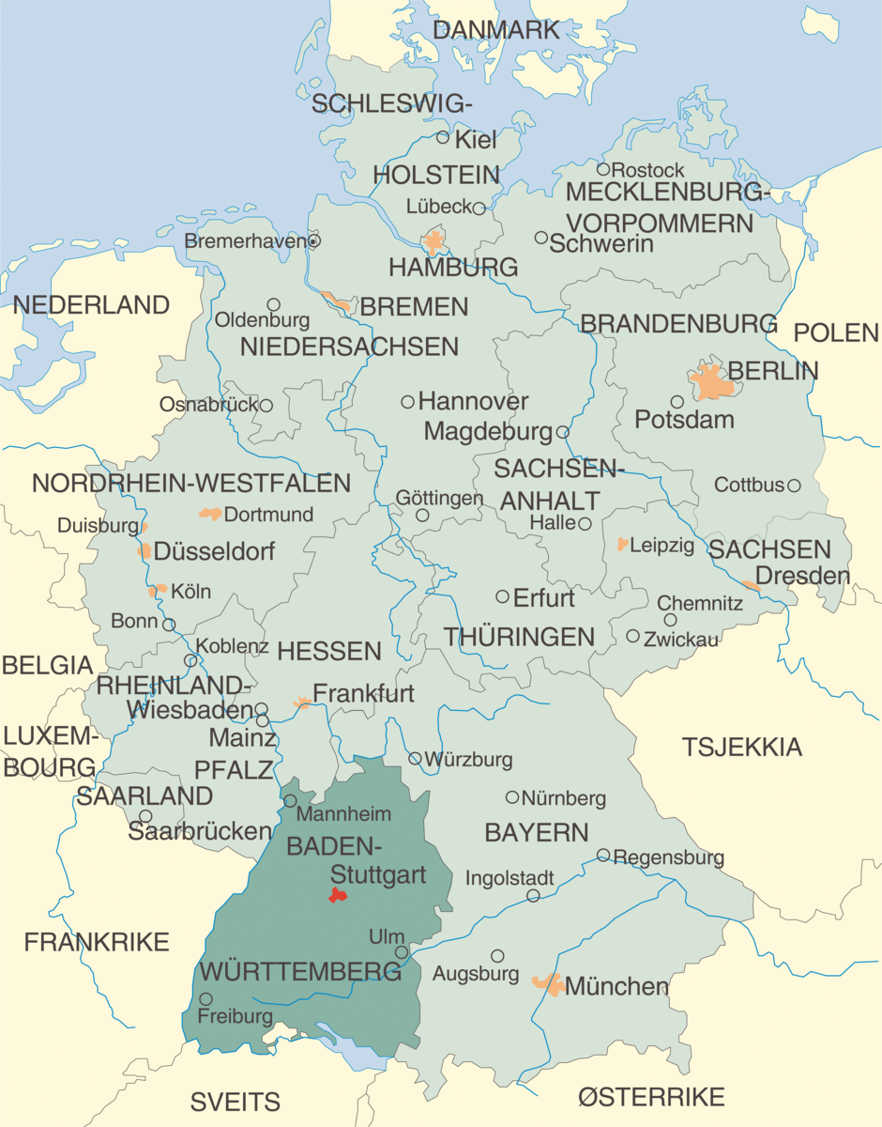
GEOGRAPHY
Located in Baden-Württemberg
Rhine passes through
Germany-Switzerland border runs along the city

Slide 4
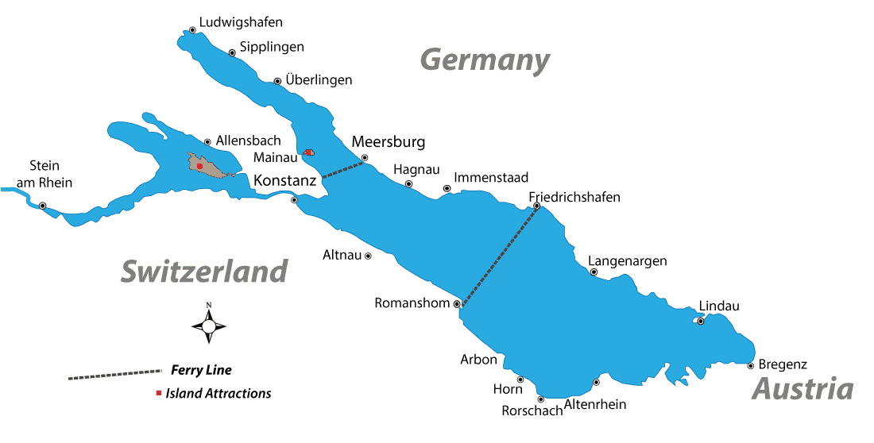
LAKE OF CONSTANCE
Thirst largest lake in Germany
Situated at the northern foot of the Alps
Between Germany, Switzerland and Austria
Splitted into two sections
Three bodies of water
Rhine flows into the lake

Slide 5
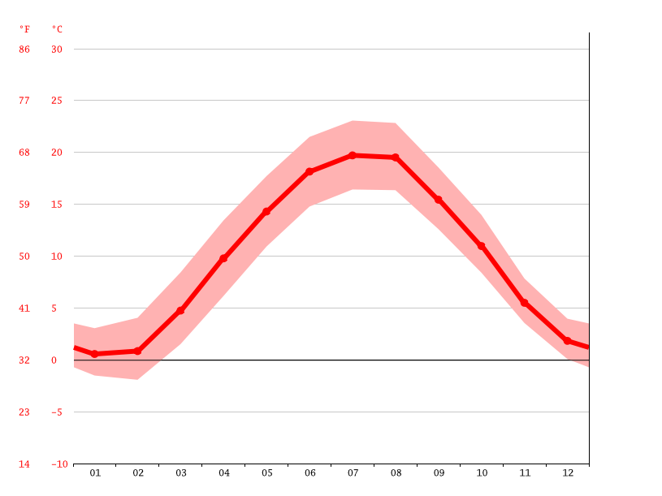
WEATHER
Weather-Summers in Constance are pleasantly wet and winters are very cold. It is rather cloudy all year around. Temperatures range from –2 to 25 degrees. July is the warmest month with an average high temperature of 25 degrees.

Slide 6
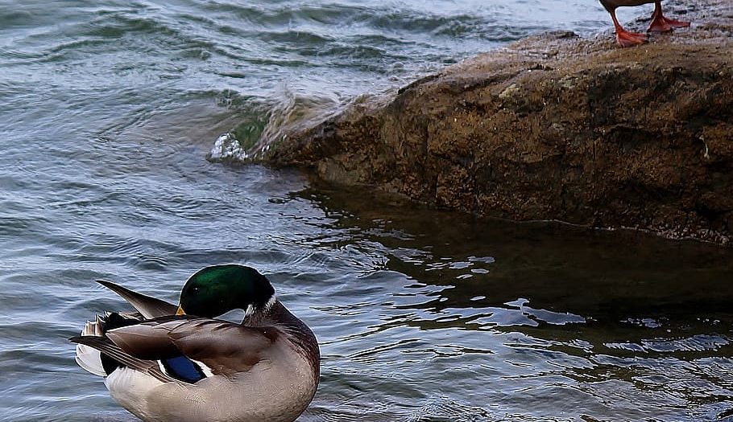
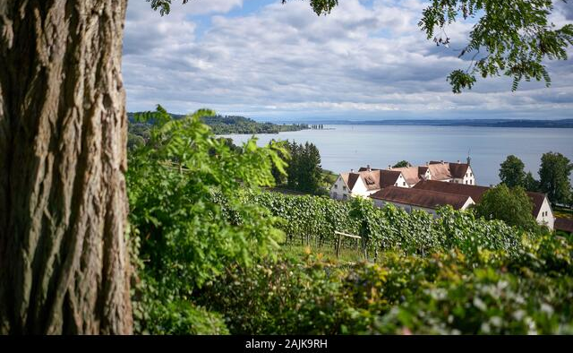
NATURE
Many nature reserves, where many birds live
A species that abound is the wild duck
There are 4120 types of animals and 45 of them live in the water
There are areas where the landscapes are preserved

Slide 7
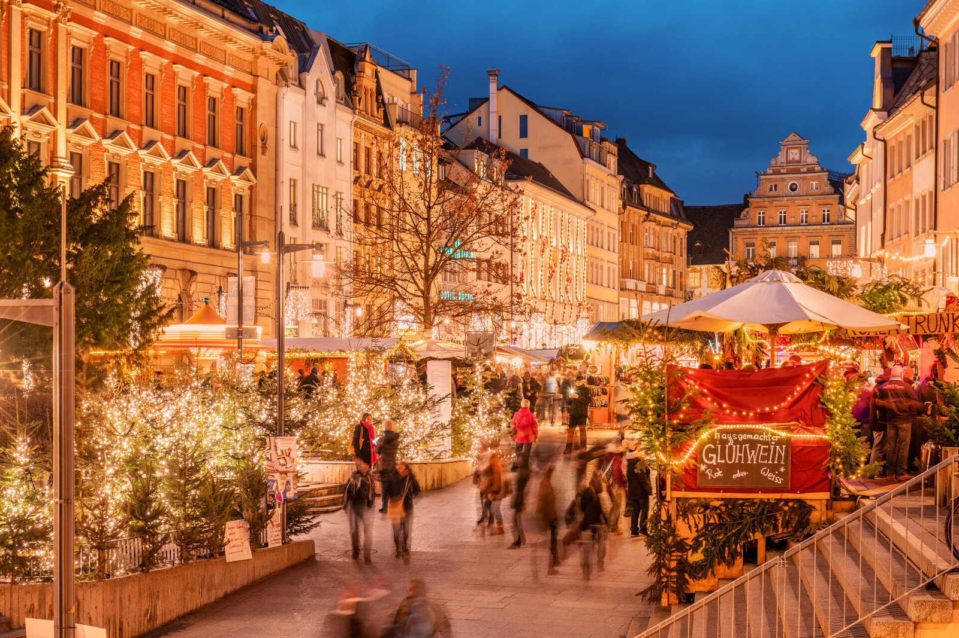
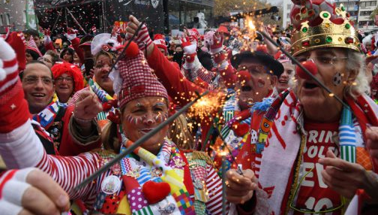
CULTURE
Festival: Winter market & Carneval
Food:
Appels, they have really good apples
Wine, Weingut since 1225
They have many restaurants with typical food for constance
Different kind of restaurants such as German, Italy, Asia,
Many caffee

Slide 8
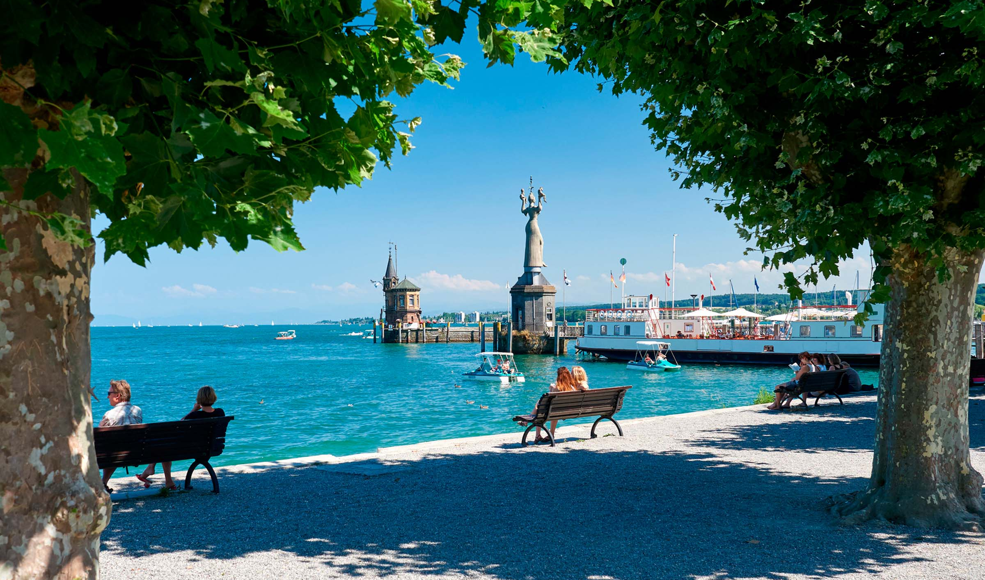
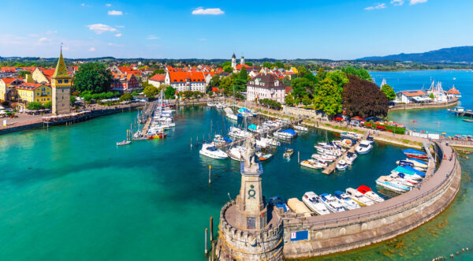
TOURISMUS
Lake of Constance
Is the largest lake in Germany
Perfect destination for sailing and water sport enthusiasts
Cycling

Slide 9
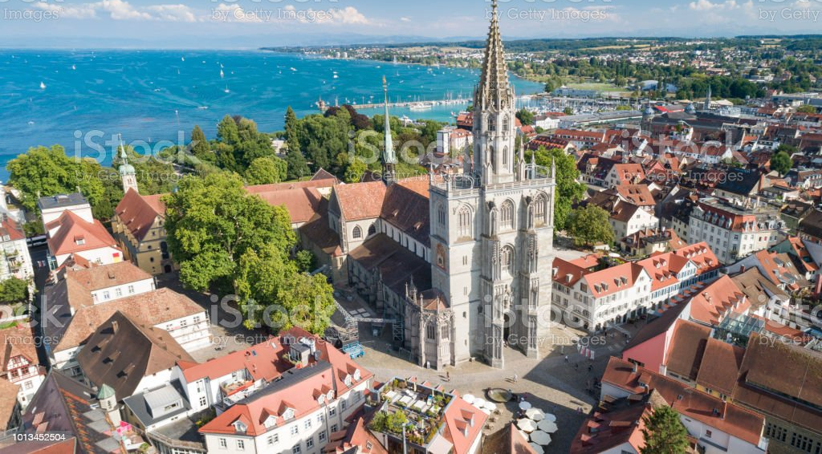
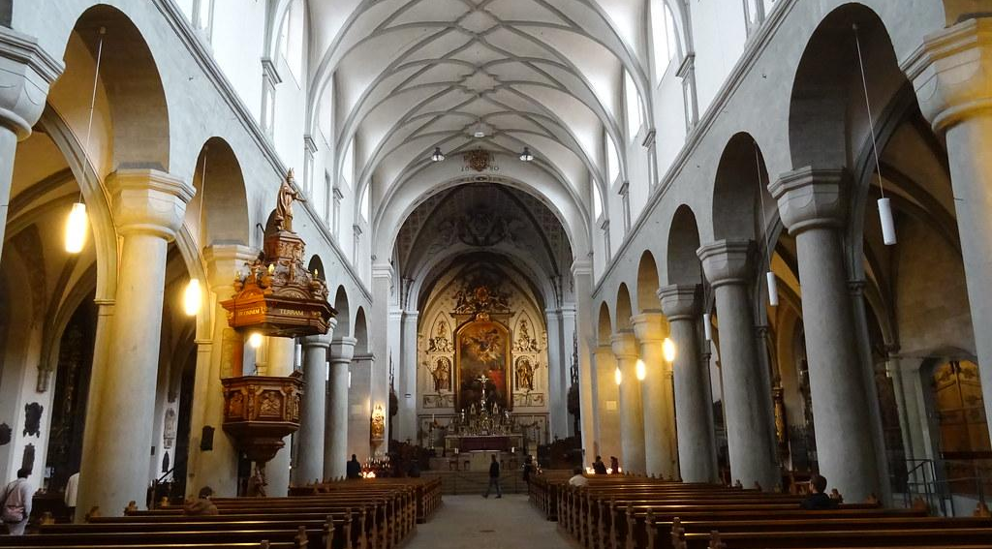
The ancient Constance Minster Old Town
Close to the Swiss frontier
Significant cultural hub
Konstanz minister is one of the ancient buildings
Back to the 11th century
Other attractions in the Old Town include:
The eye-catching 15th-century Hohenzollernhaus
The captivating 16th century Rathaus
The Haus Zum Rosengarten
The medieval butcher’s guild-house which is now occupied by a museum

Slide 10
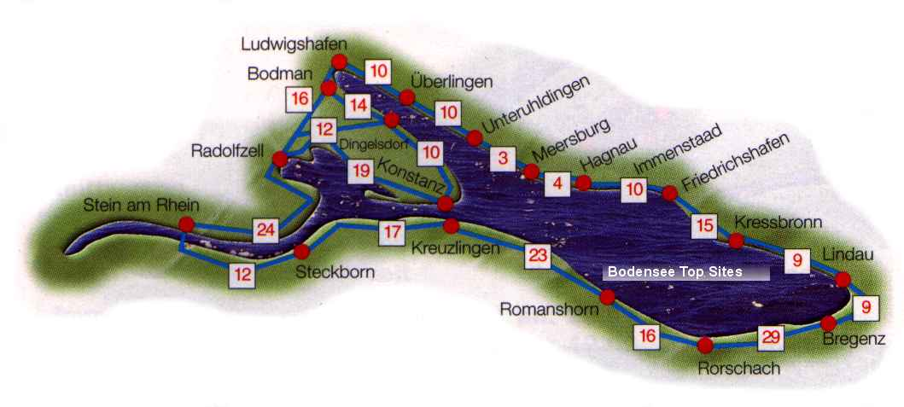
The Cycling Trail from Bodensee to Rundwanderweg
Perfect for the walkers and cycling enthusiasts, the Lake Constance Trail encompasses the lake, at safe distances from its beautiful shores, for about 272 kilometres.

Slide 11


