Slide 1
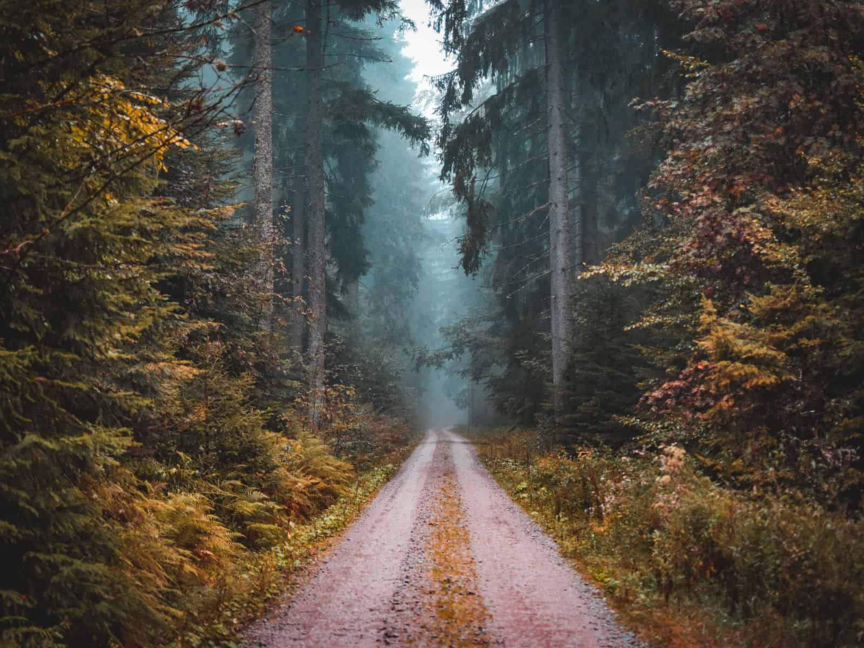
BLACK FOREST AREA
Felipe Bachmann, Jacqueline Plapp, Tim Kiessling, Yeray Reyes, Aitana Bohórquez, Óscar Kronborg, Vald Ursu, Javier Sánchez.

Slide 2
STRUCTURE
INTRODUCTION……………………………..Page n°3
RIVERS AND LAKES…………………………….Page n°4
CULTURE……………………………………….Page n°5
FOOD………………………………………………Page n°6
ECONOMICS…………………………………………….Page n°7
ANIMALS……………………………………………..Page n°8
WEATHER………………………………………………..Page n°9
NATURE……………………………………………….Page n°10-11

Slide 3
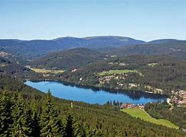
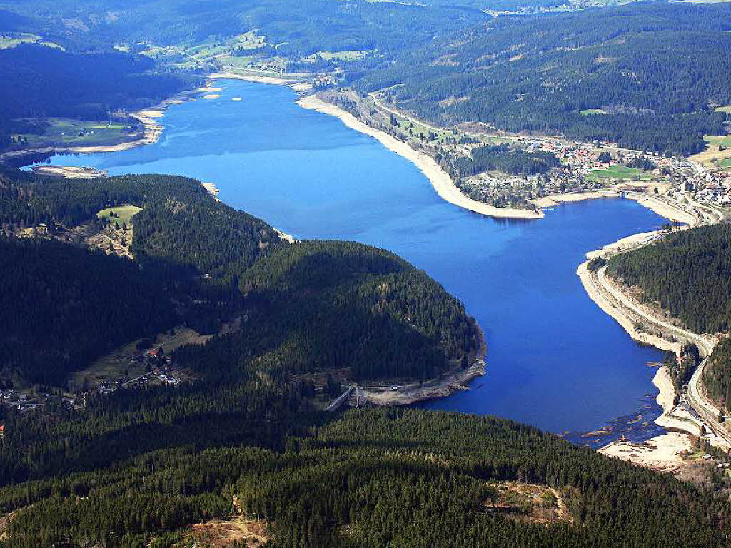
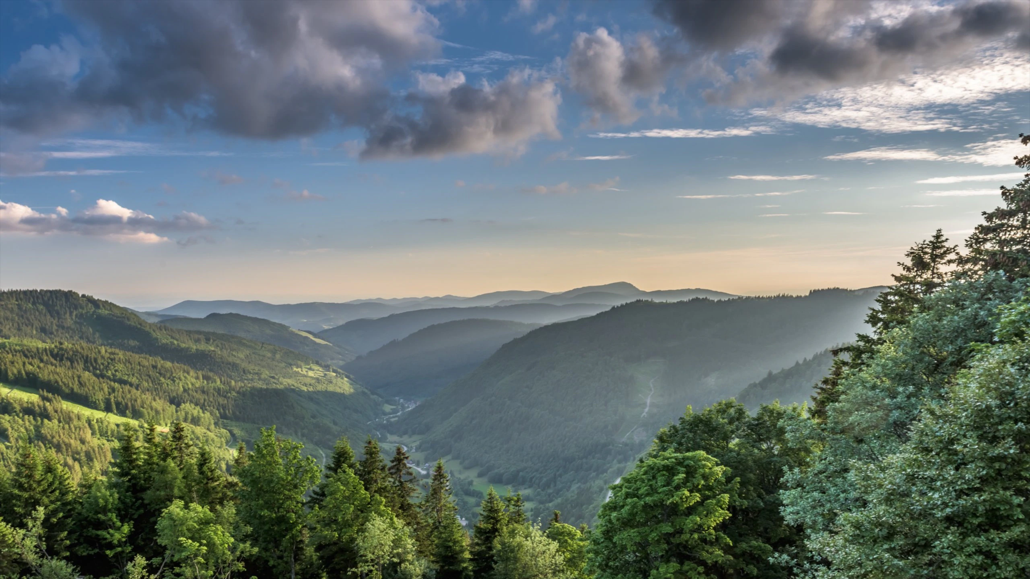
INTRODUCTION
This is a large forested mountain in south-west Germany, in the state of Baden-Württemberg.
The highest mountain is Feldberg with a height of 1493m.
It’s length is 160 km ands it’s area is around 6000 km².
There are a lot of rivers through it, such as Neckar, Danube or Rhine and the most important lakes are Tittisee and Schluchsee.

Slide 4
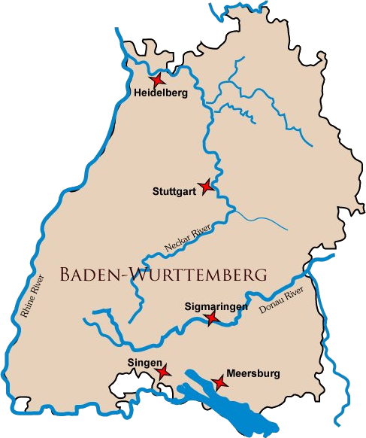
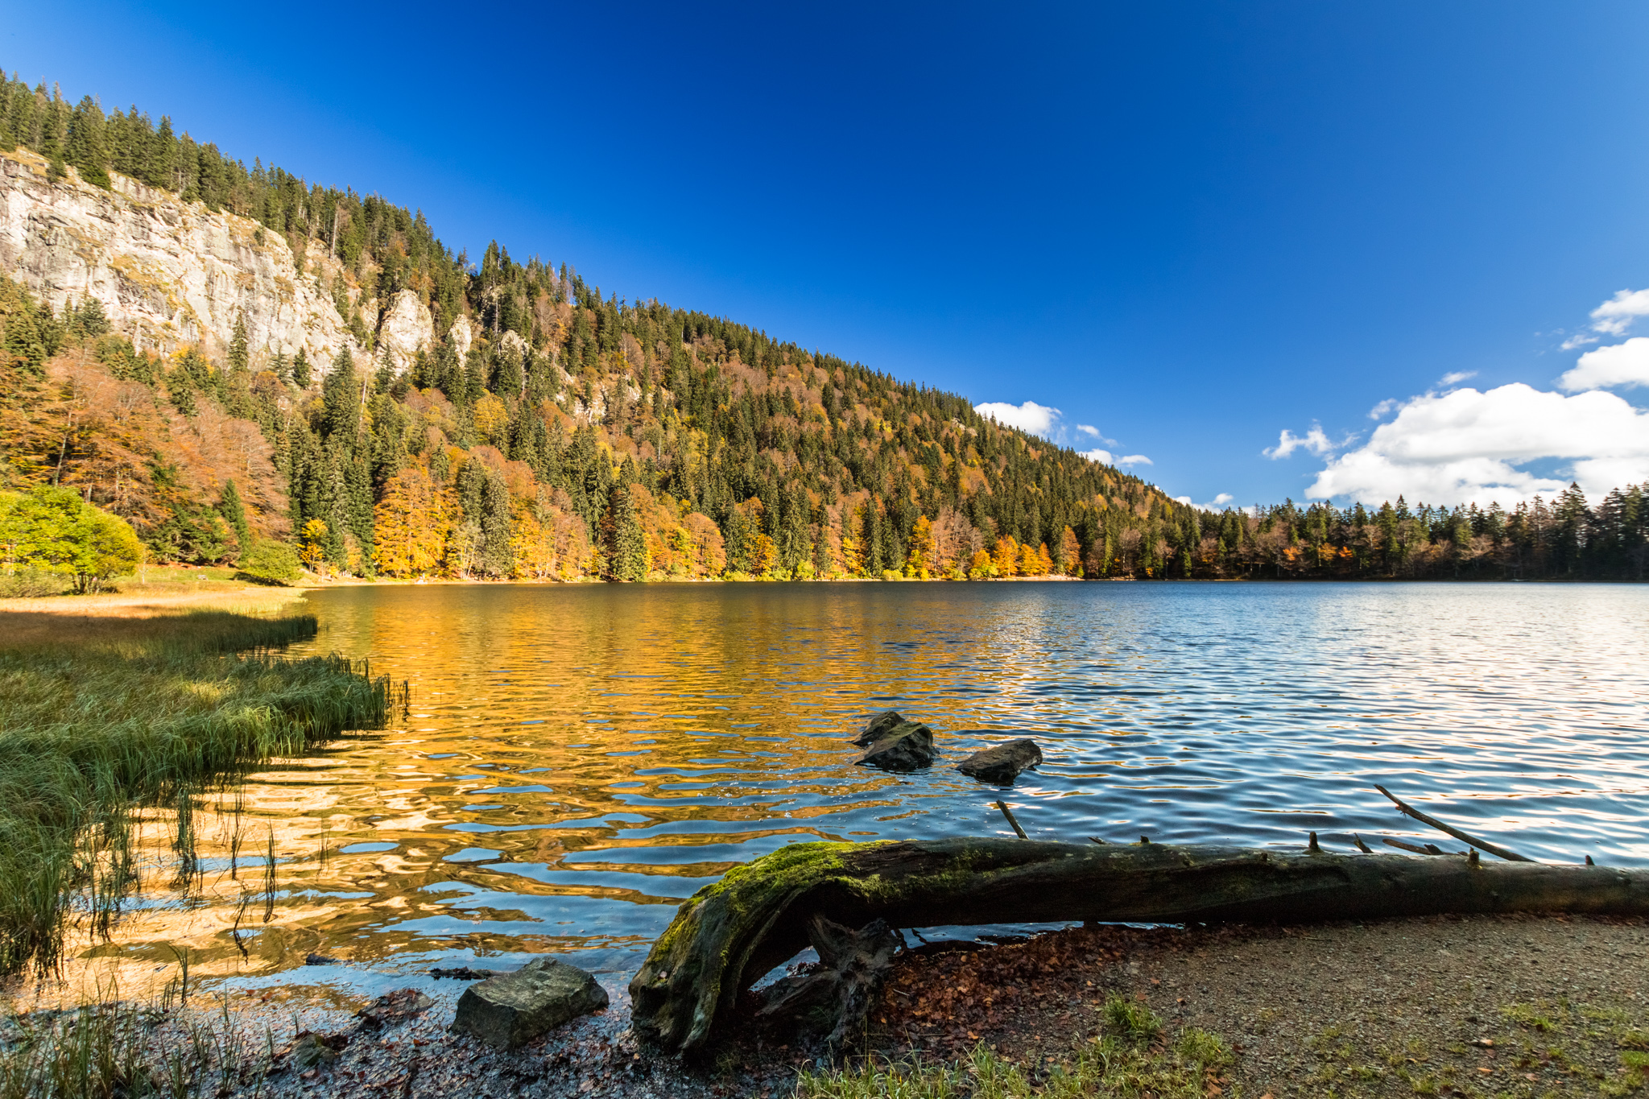
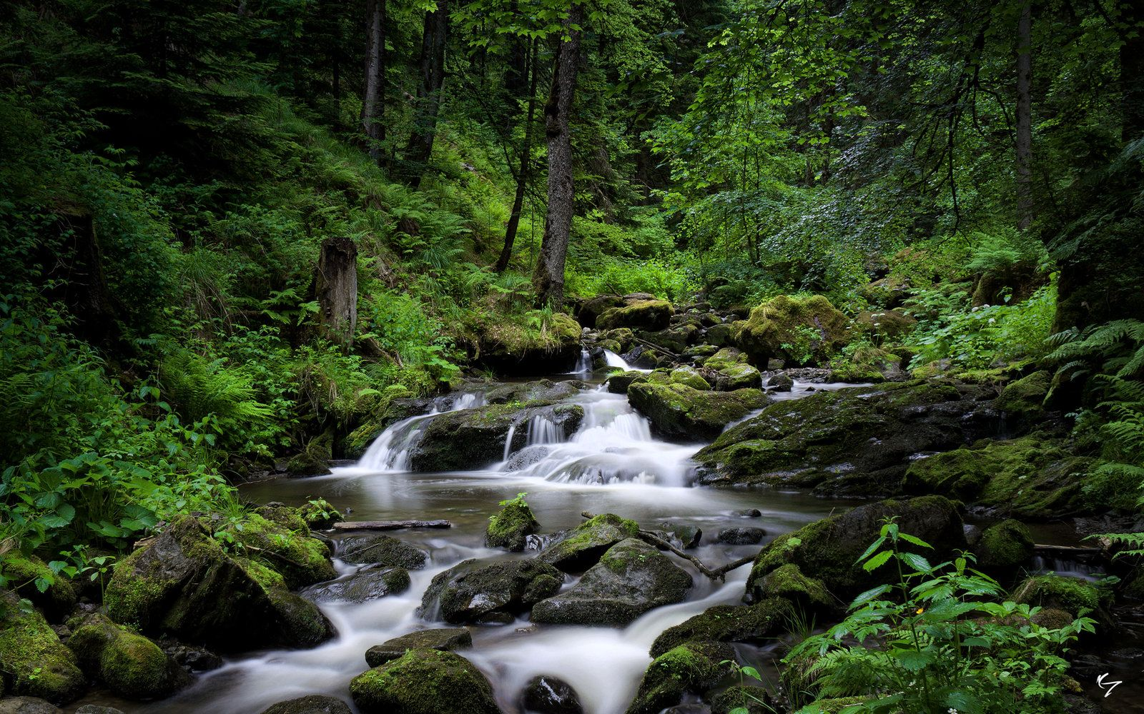
RIVERS AND LAKES
From north to south, thee Black Forest extends over 160km, and the length from east to west is over 50km
The three main rivers that run through the Black Forest are the Rhine in the far west, the Neckar across the middle and the Danube, which originates here.
The lakes are mostly of glacial origin, but there are also artificial lakes used for power generation or protection of drinking water.

Slide 5
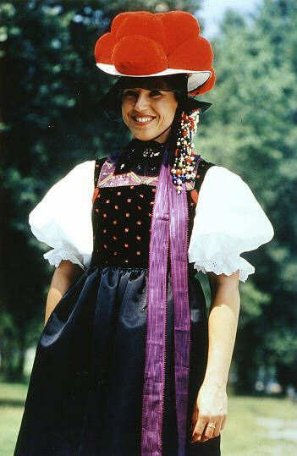
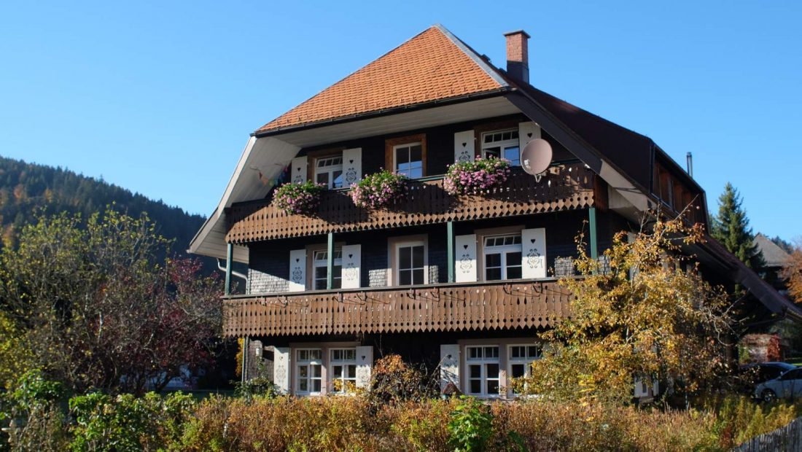
CULTURE
TRADITIONAL HOUSES IN BLACK FOREST
TRADITIONAL COSTUME

Slide 6
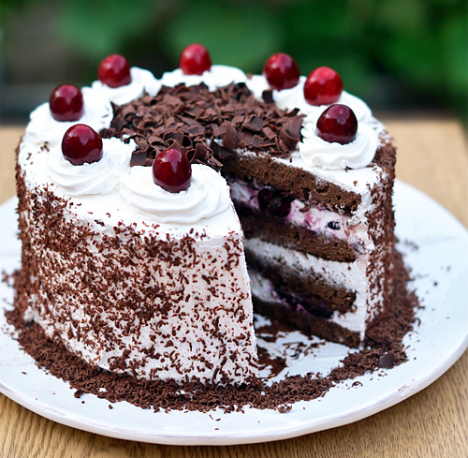
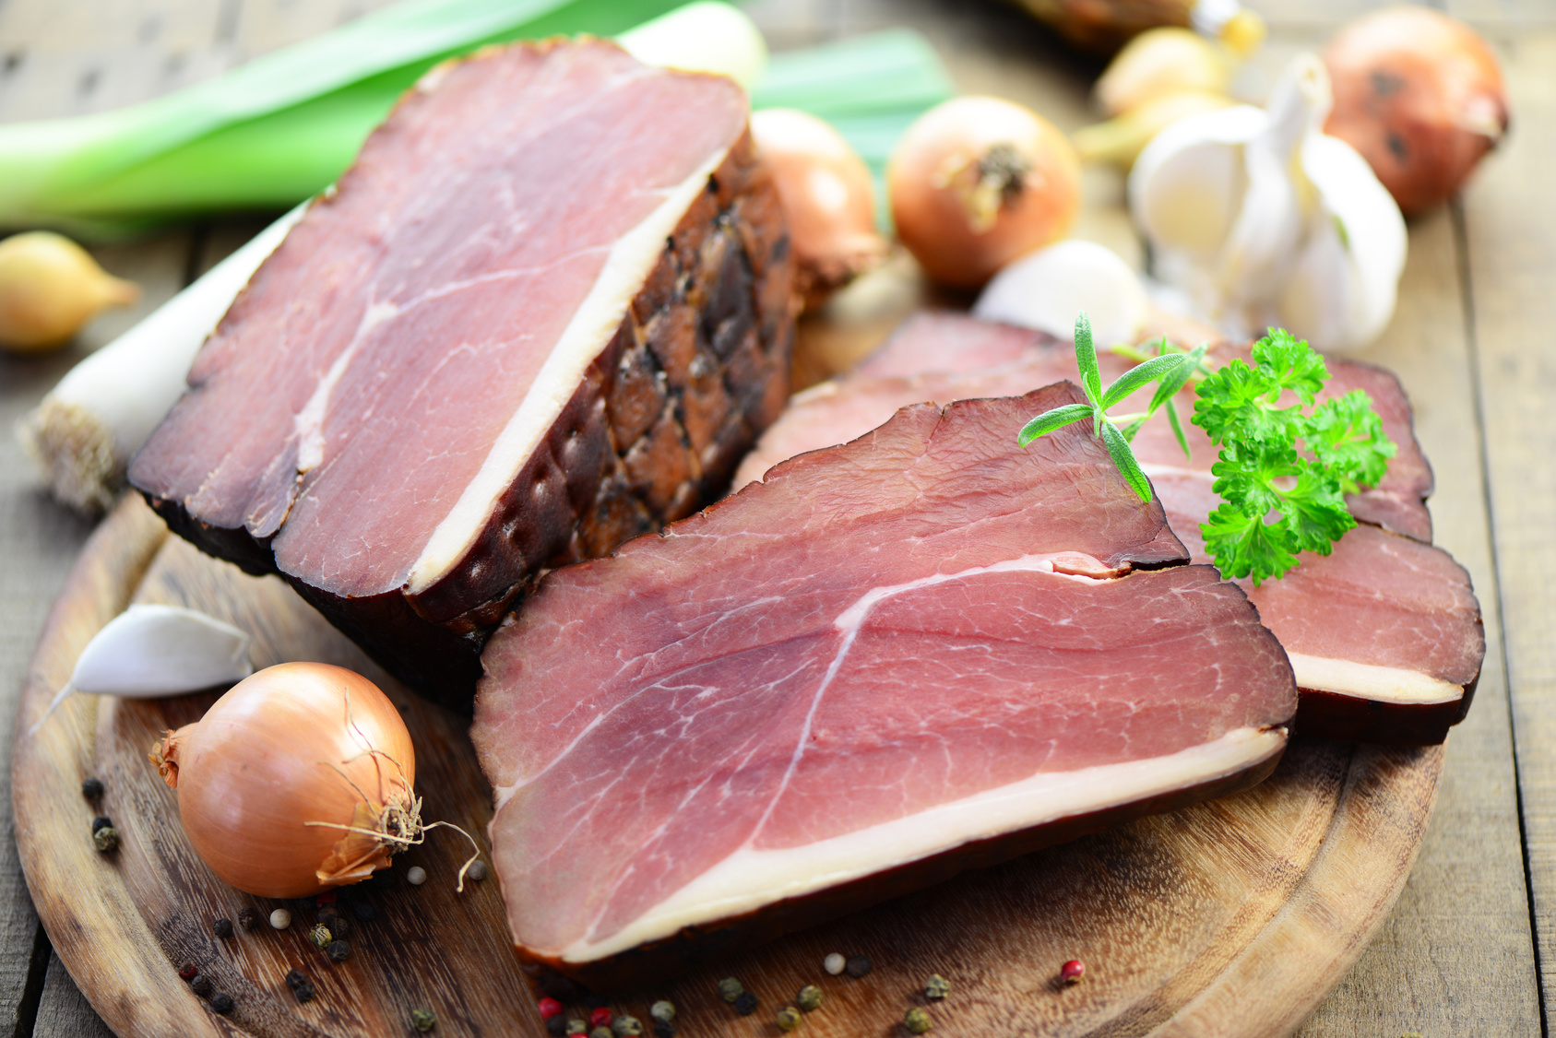

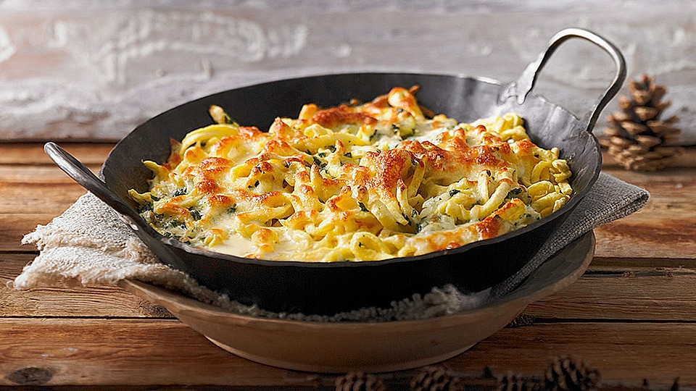
FOOD
BLACK FOREST HAM
SCHWARZWÄLDERKIRSCHTORTE
(BLACKFOREST CAKE)
MAULTASCHEN
(MEAT-FILLED NOODLES)
←
KÄSSPÄTZLE
(NOODLES WITH CHEESE)
→

Slide 7
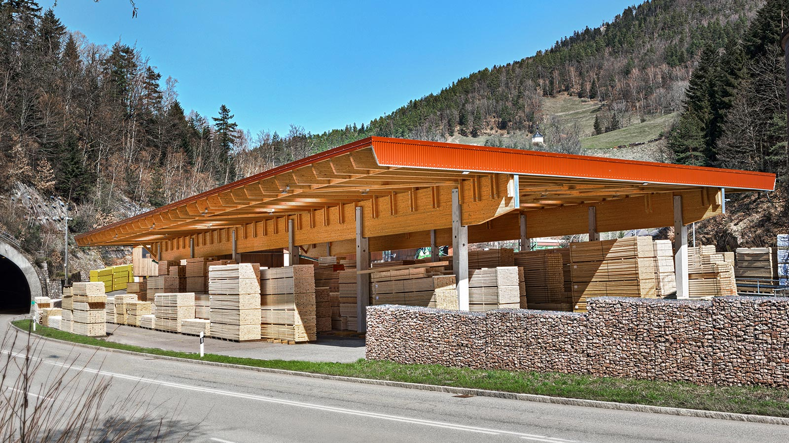
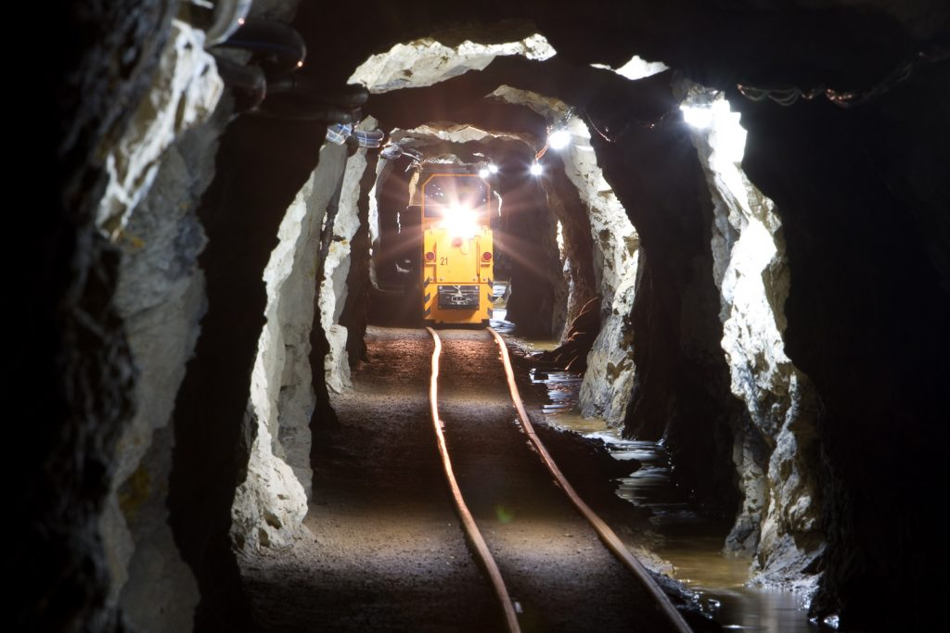
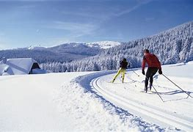
ECONOMICS
This area was known for forestry and the mining of ore deposits, but now the tourism is the primary industry, with 300.000 jobs.

Slide 8
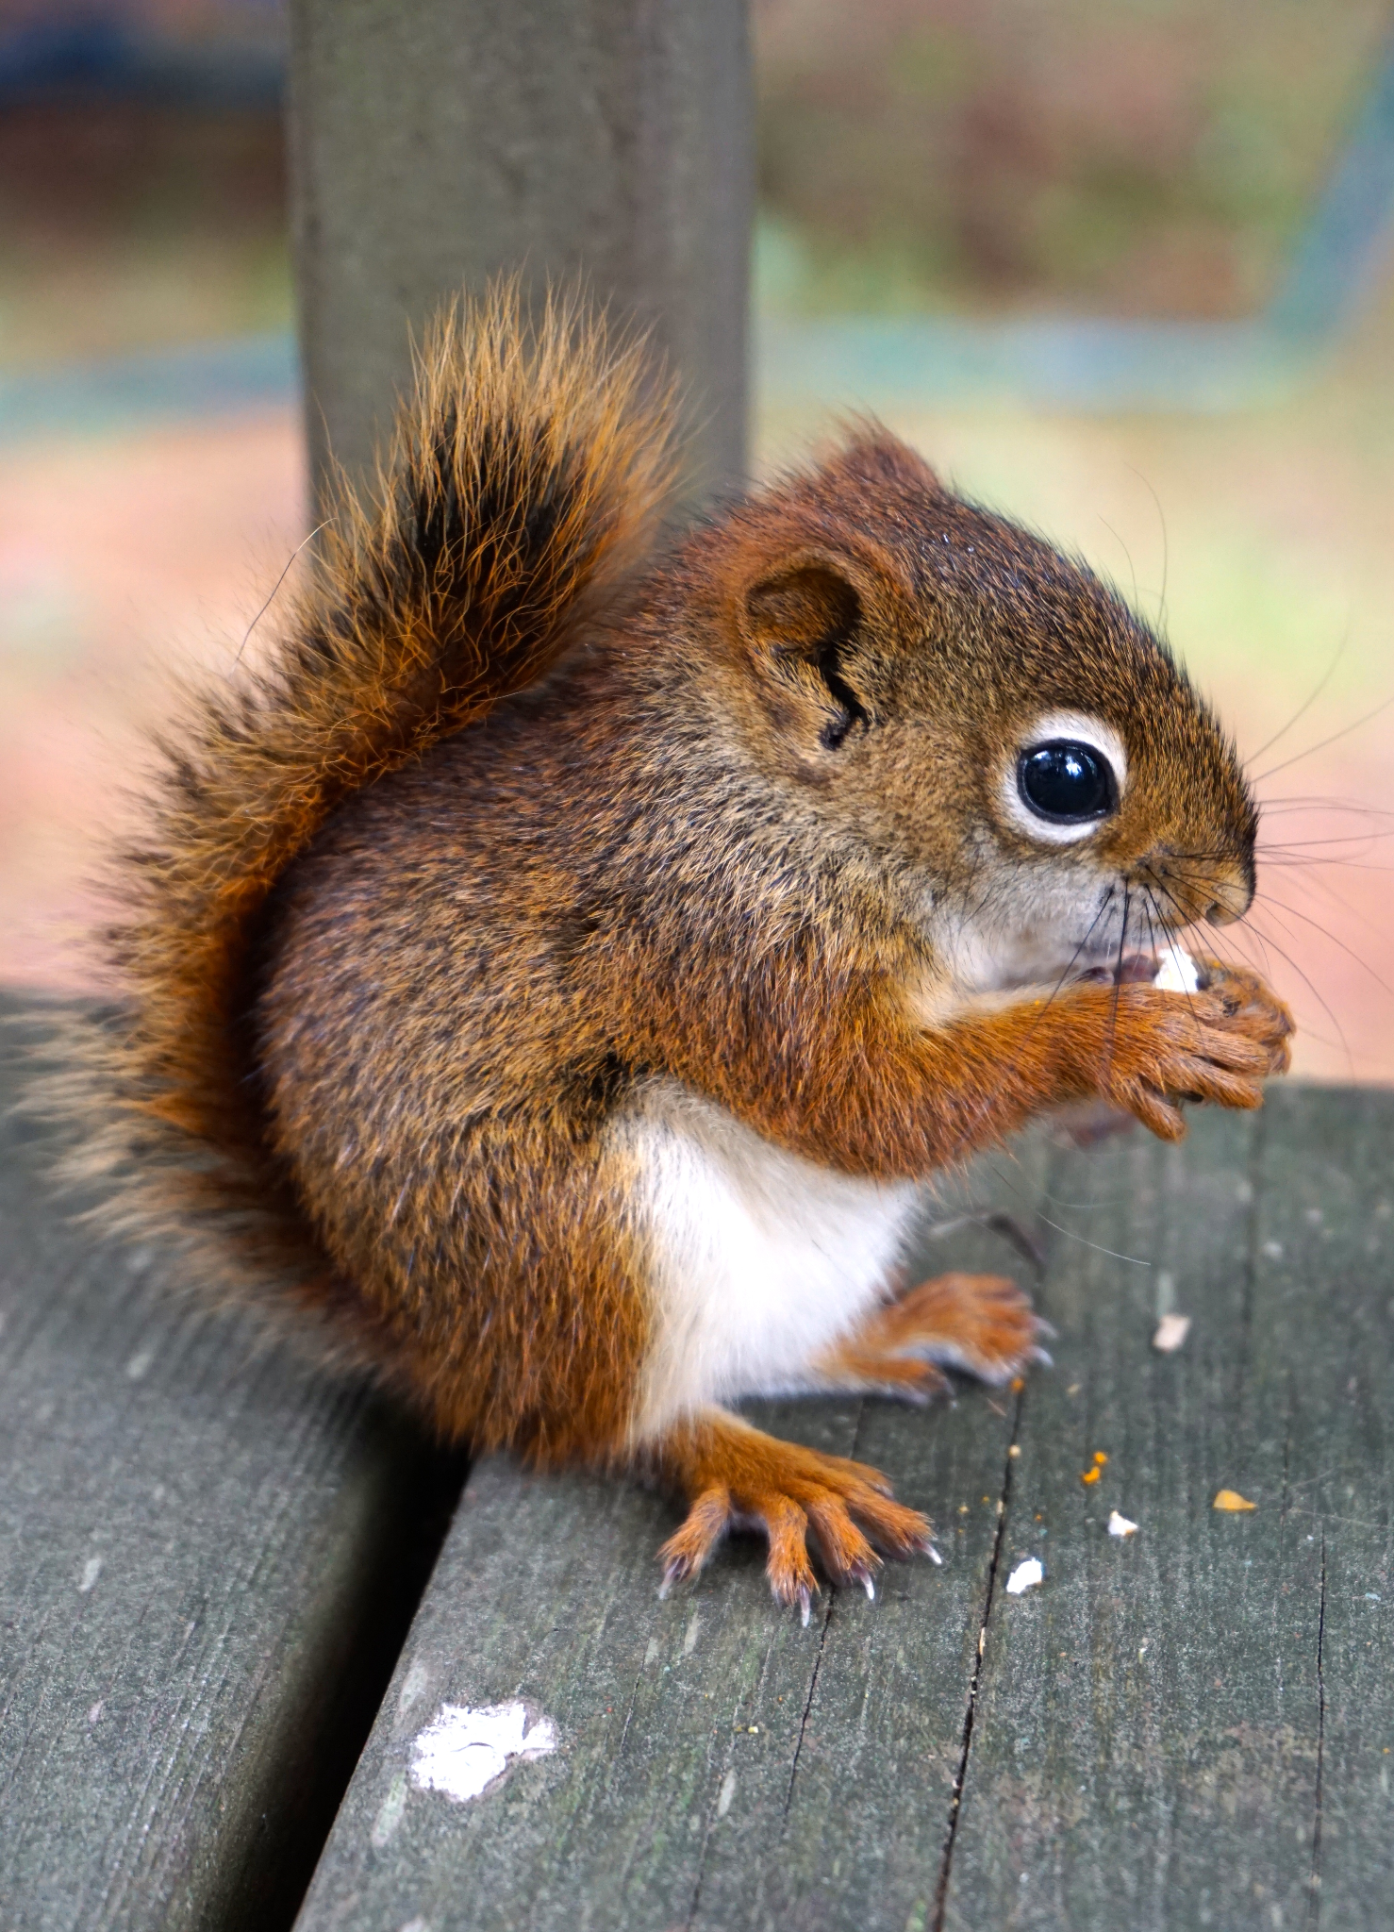
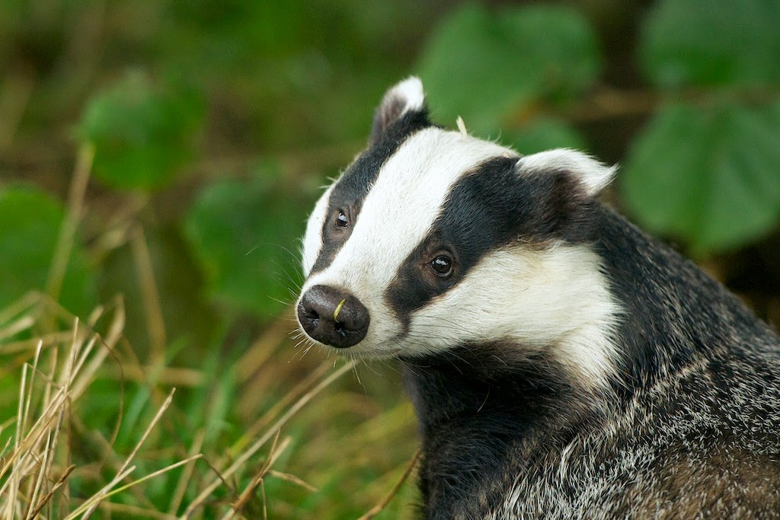
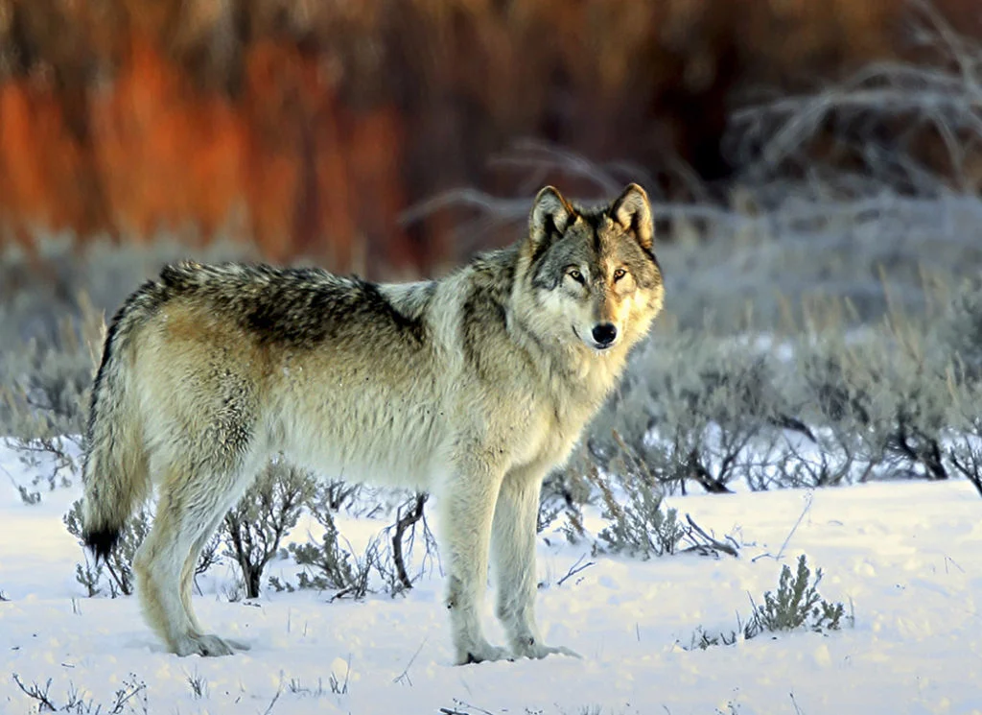
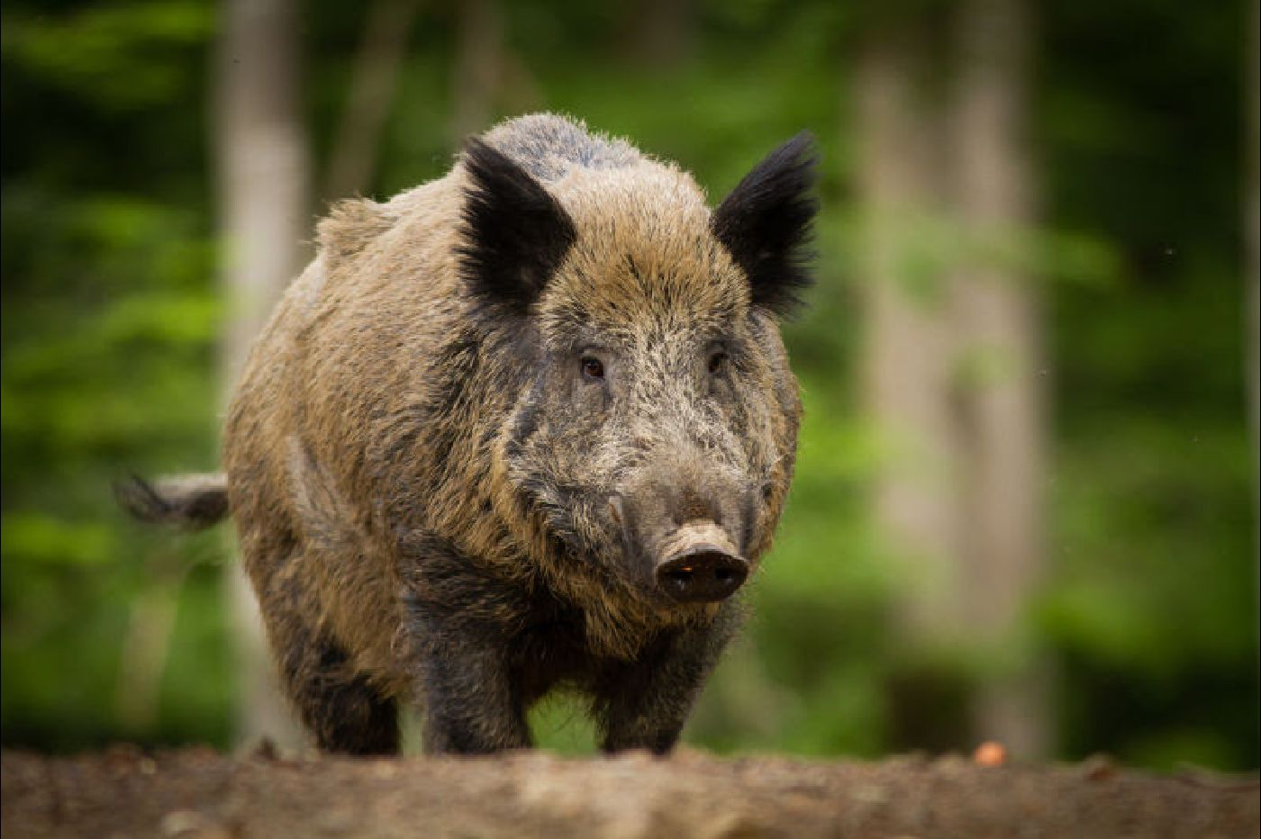
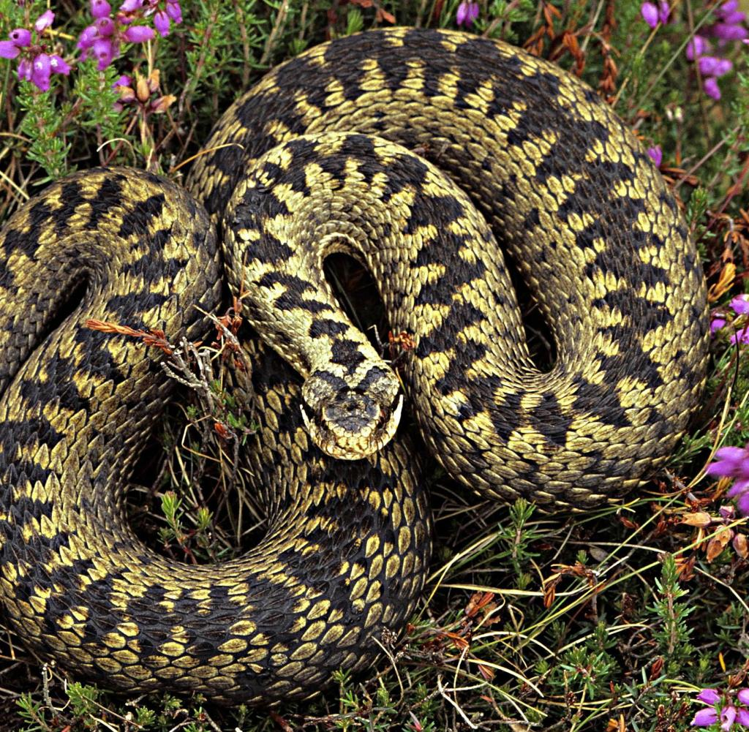
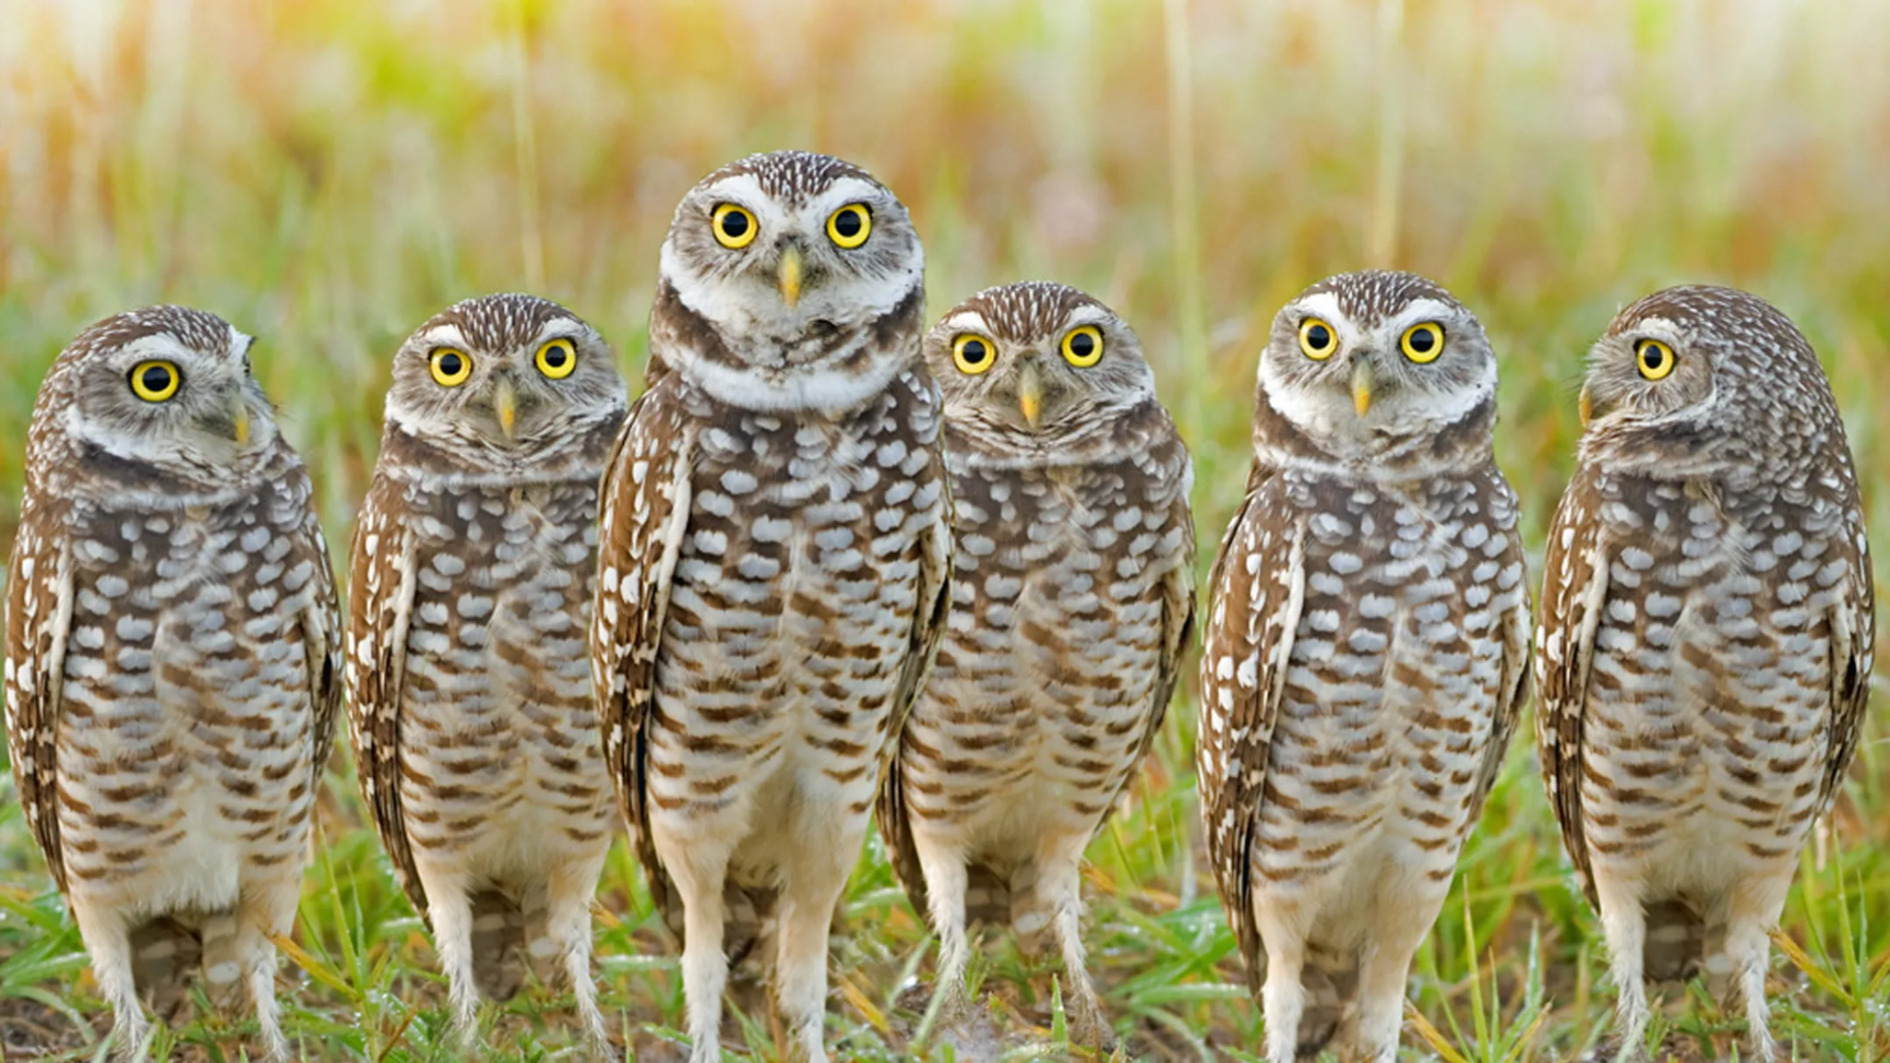
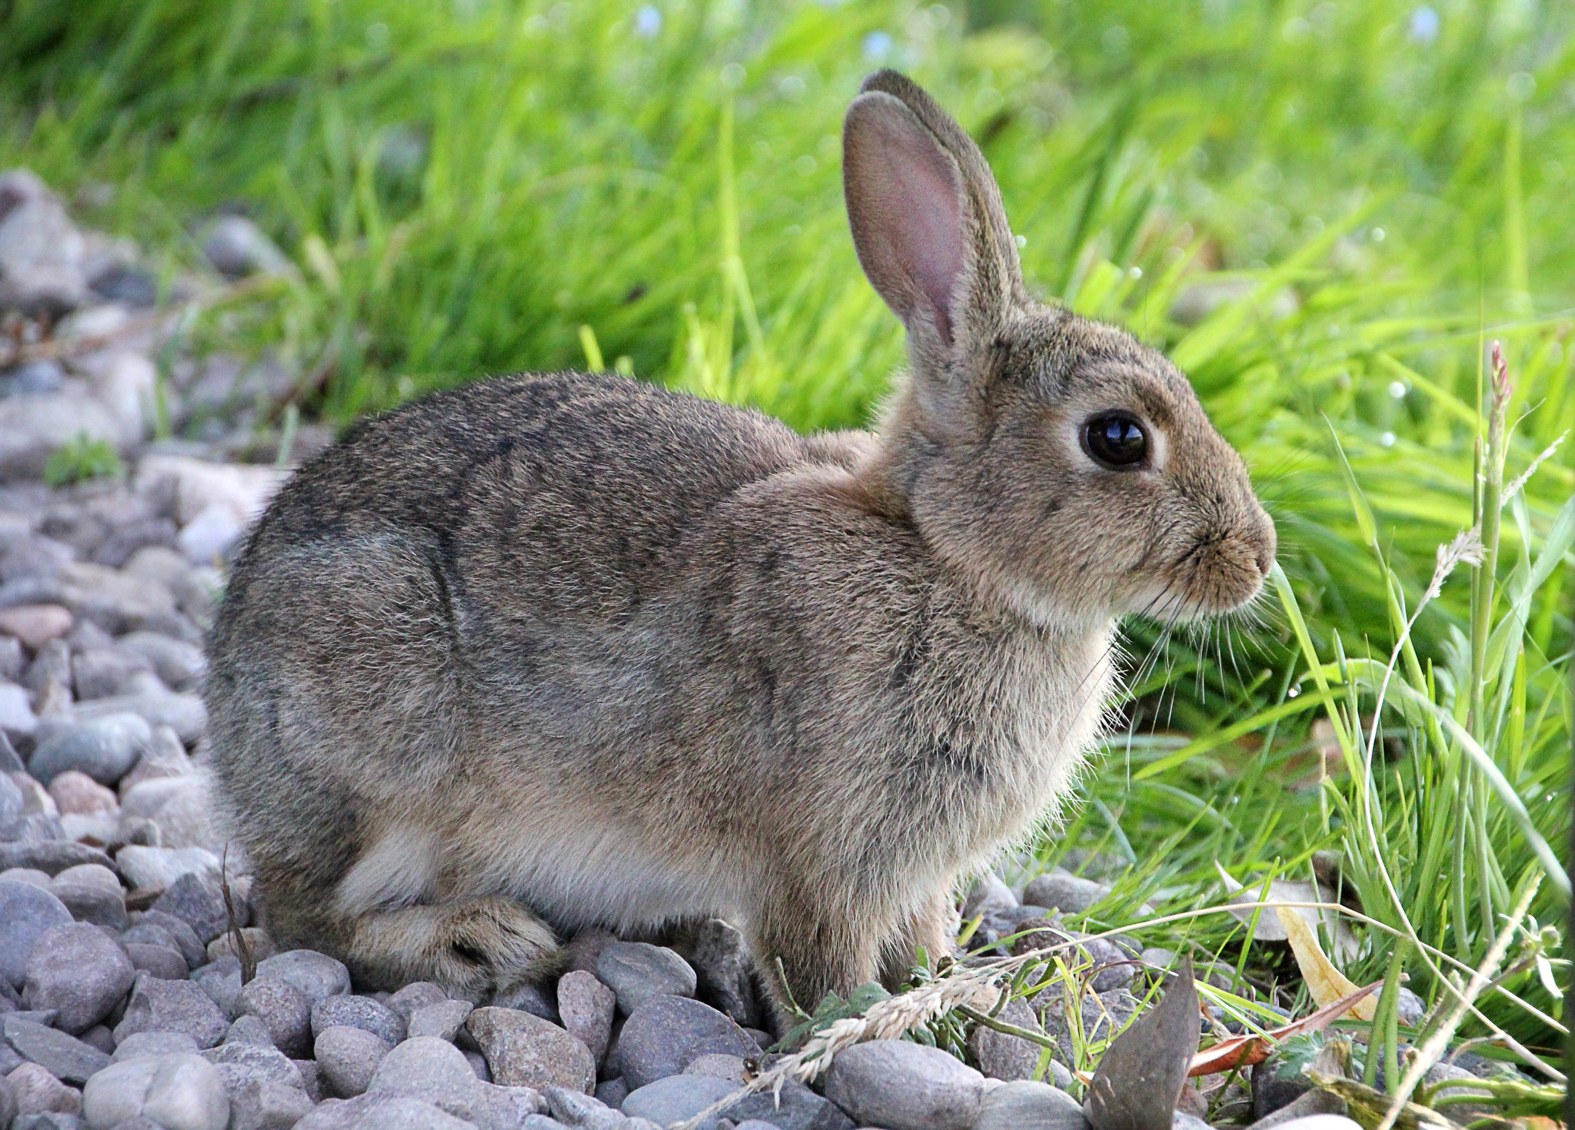
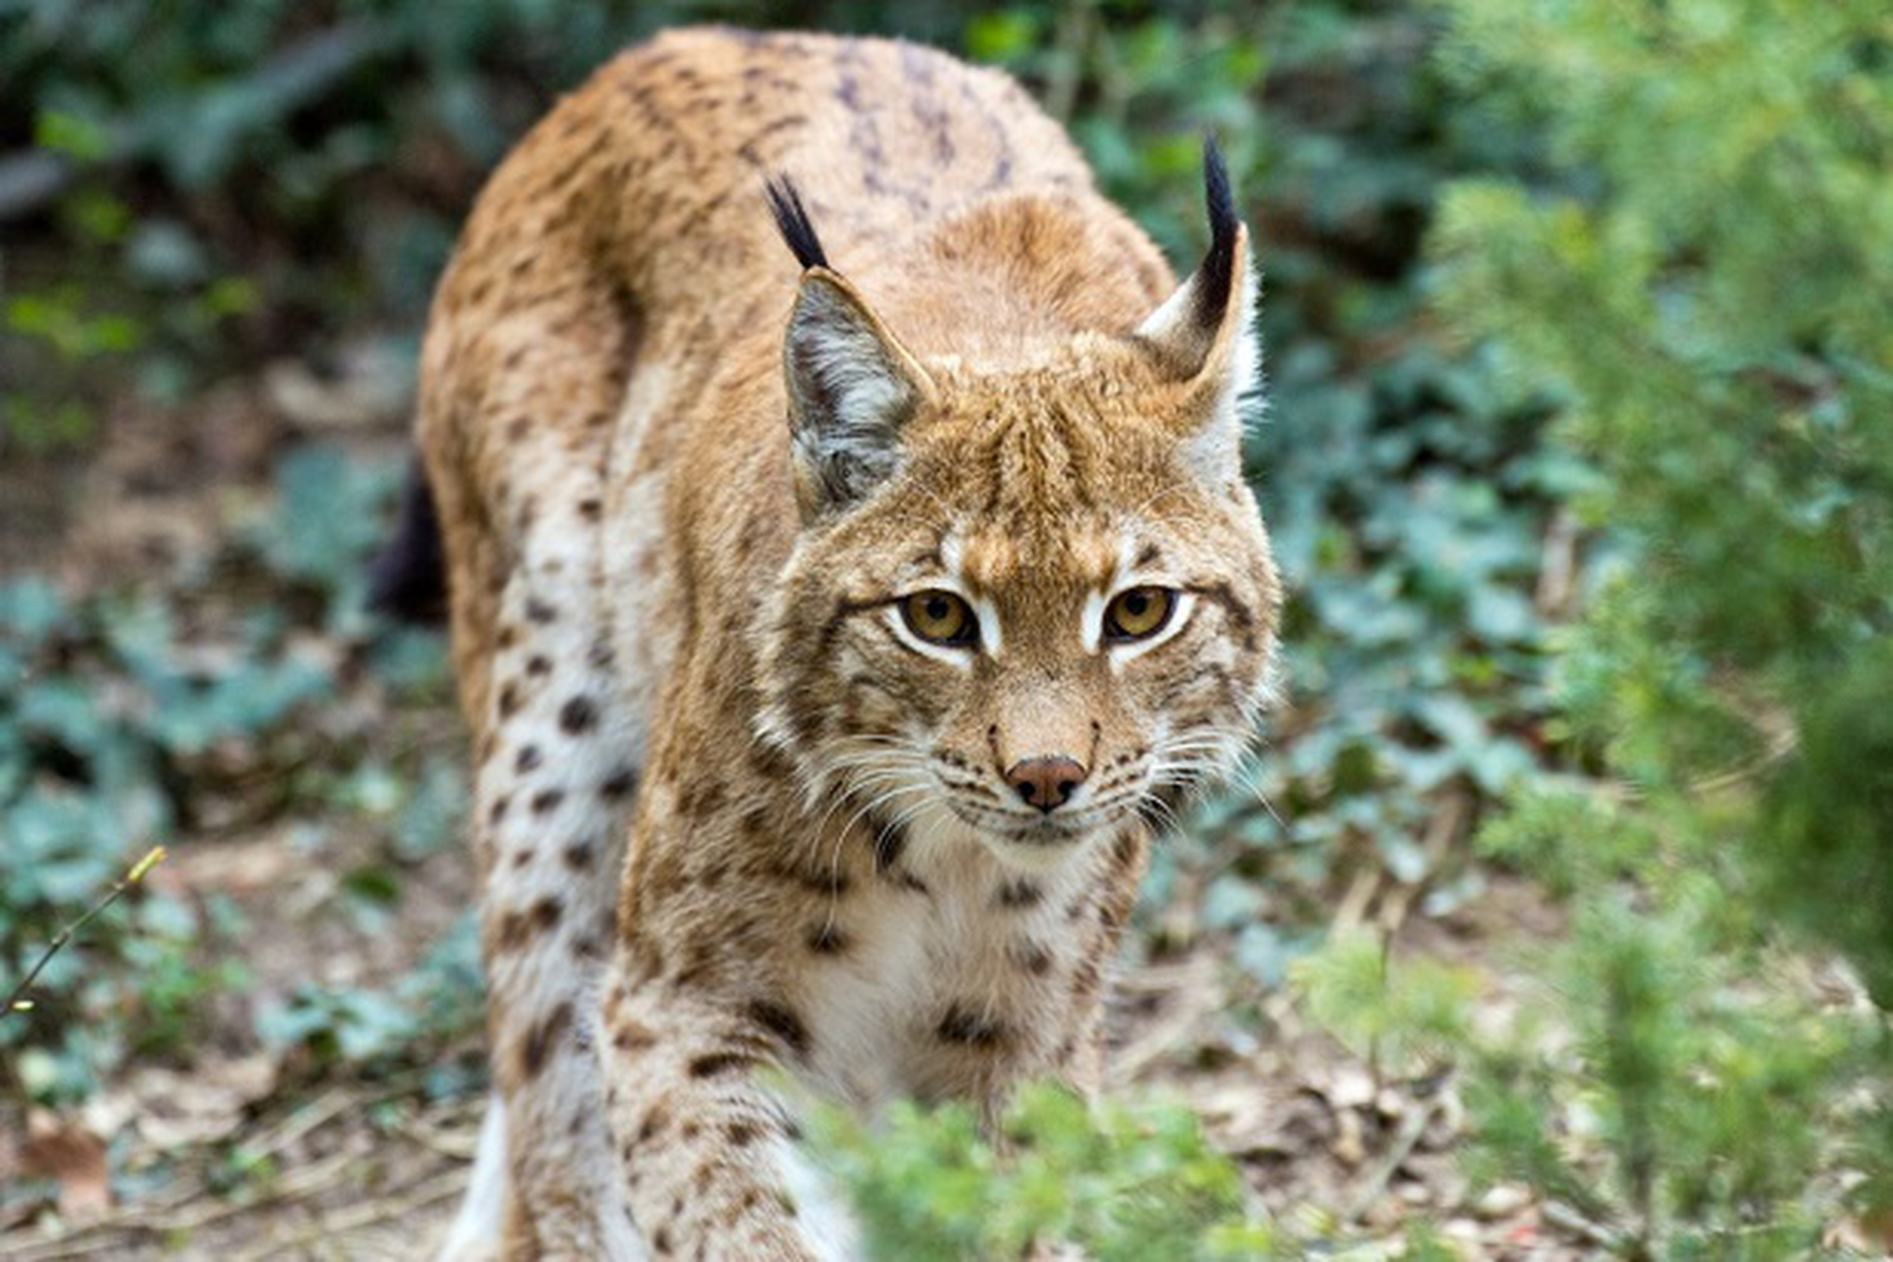
ANIMALS
There are a lot of animals living here, such as owls, wolves, rabbits, deers, boars, squirrels, lince, badgers, snakes, foxes and wild chickens.

Slide 9
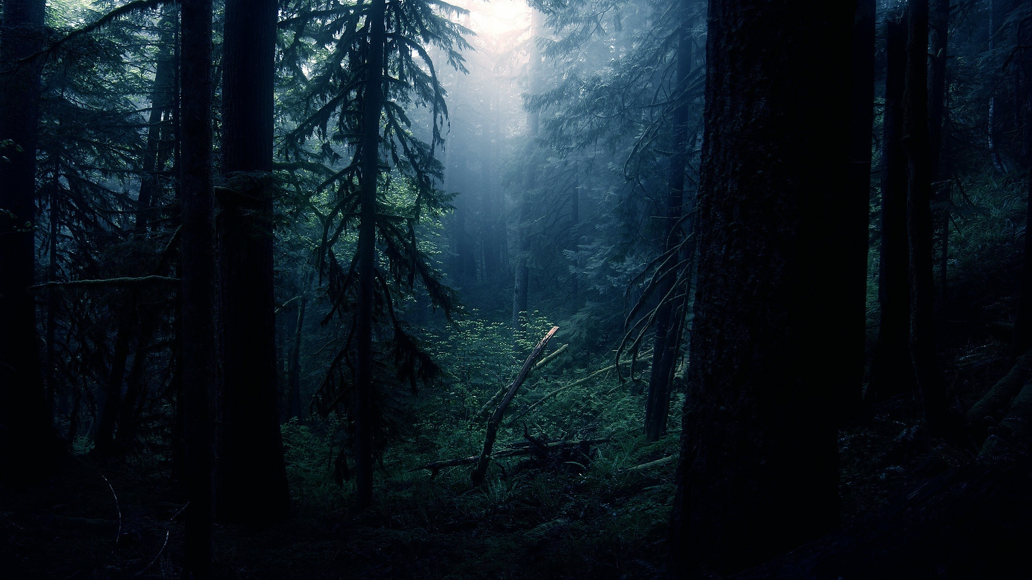
WEATHER
The Germans call the forest “Schwarzwald” which directly translates to black forest.
The origins of the name dates back to the Romans who called the forest “Silva Nigra”.
The Black Forest is one of the sunniest and warmer regions in Germany. Average high temperatures in the summer reach around 25°C, with lows only dropping around an average of 14°C.
After autumn the temperatures can reach an average low of -3°C and highs just above freezing.

Slide 10
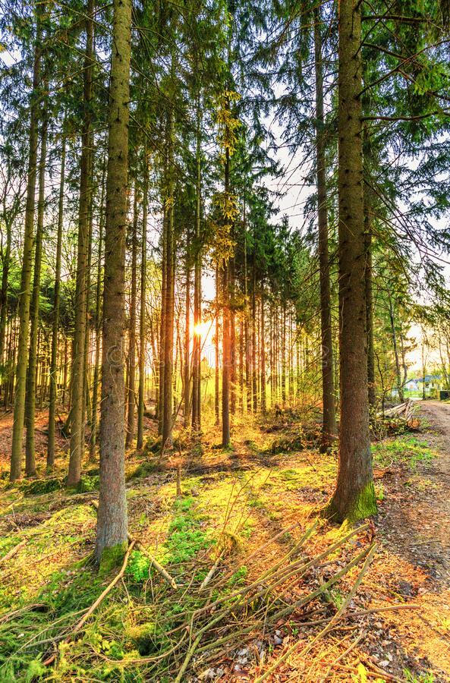
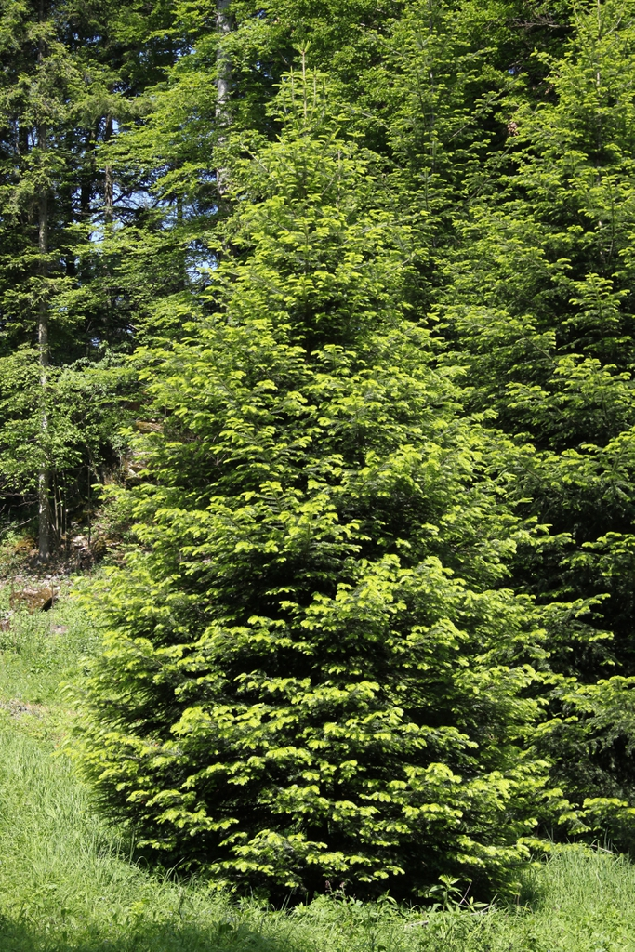
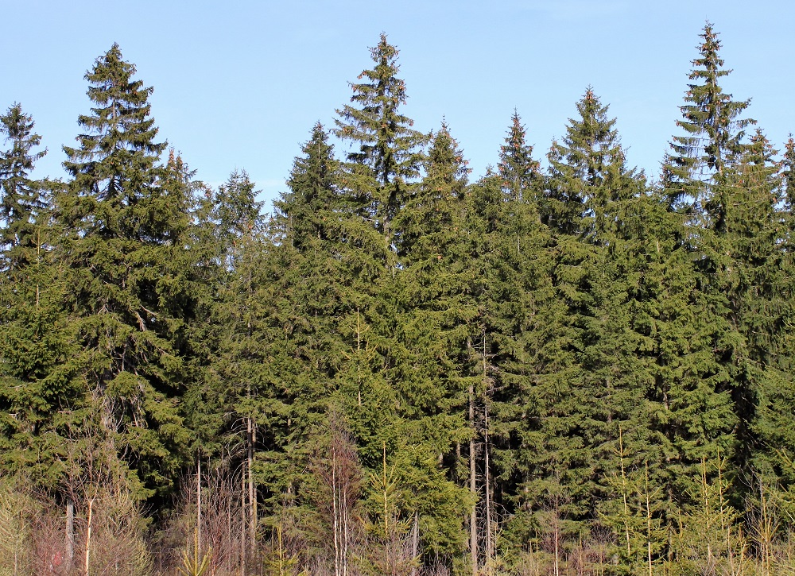
NATURE
-Canopy: Black Forest predominantly consists of a variety of pine, spruce and fir trees for example: Scot Pine, Norway Spruce and European Silver Fir.

Slide 11
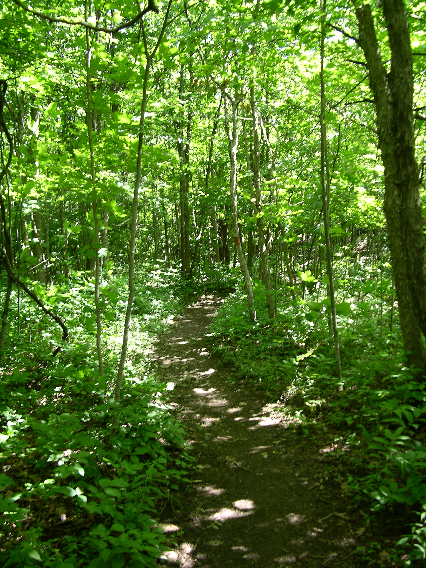
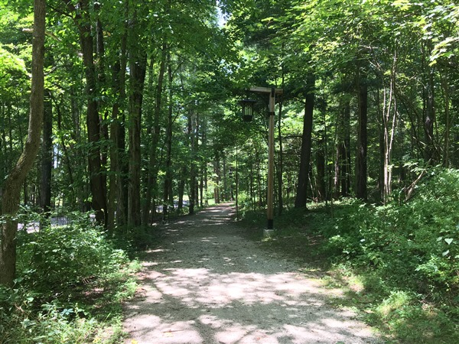
NATURE
-Understory : There isn't much understory cause of the density of the forest that don't let the light passes through. The only trees that we can find are: Beech, Oak, Hazel, Larch, Elm, Lime, Acer, Alder and other various broadleaf trees.

Slide 12
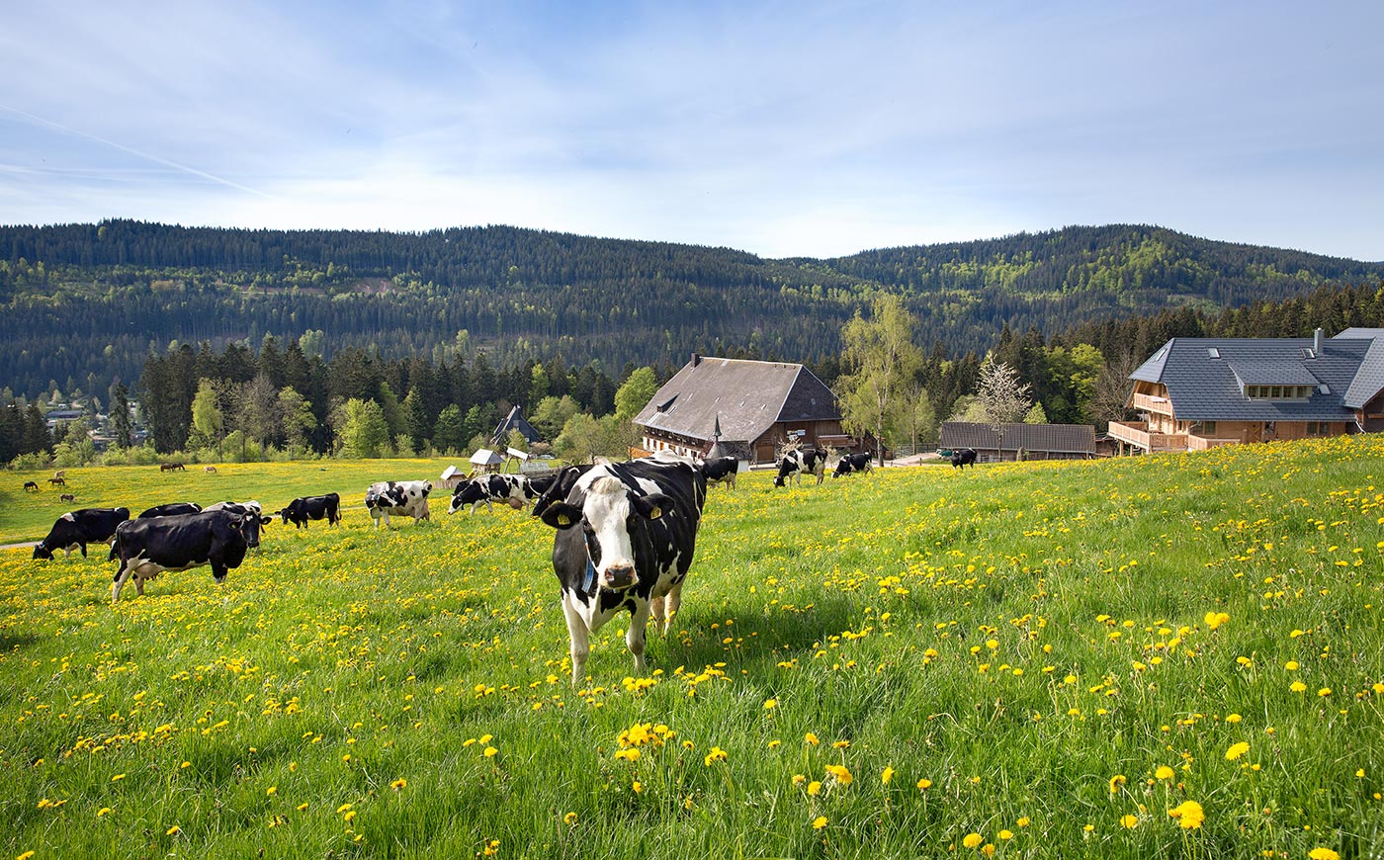
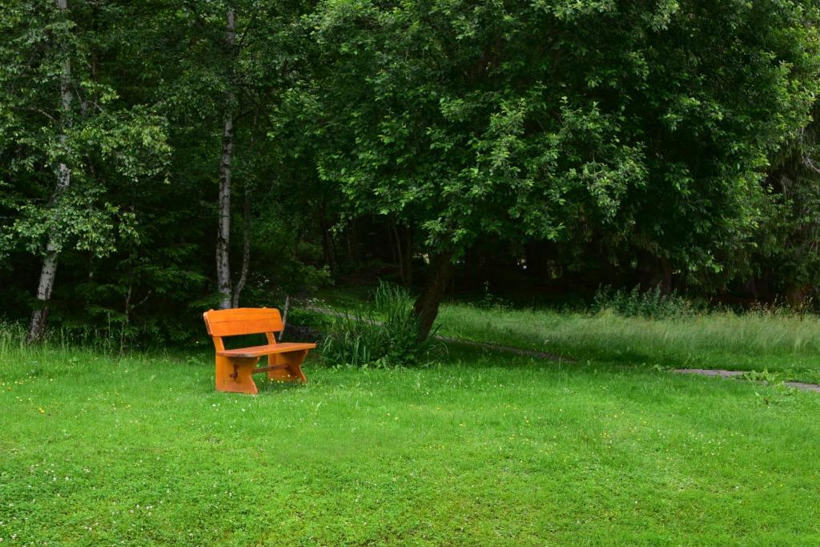
NATURE
-Ground cover : There are various types of scrubs, ferns and grass that grow in the black forest. The valleys of the forest are used for grazing and animal consumption due to its very high quality.

